Slide 1
Anchored Semi-Unification
Tobias Tebbi
Final Talk – Master Thesis

Slide 2
Overview
Motivation: Translation Validation
Nonnested Recursion Schemes
Anchored Semi-Unification

Slide 3



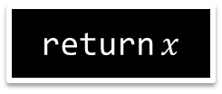
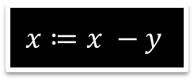




Motivation: Translation Validation
Check semantic equivalence of input and output of an optimization phase.
$$y≔2∗y$$
$$x≔x −2∗y$$
$$x≔x −y$$
$$x≥0$$
$$x<0$$
$$x≥0$$
$$x<0$$
return $x$
return $x$

Slide 4











Recursion Schemes
Encode the CFGs as recursion schemes
$$y≔2∗y$$
$$Q_{1}\left(x,y\right)≔Q_{2}(x,2∗y)$$
$$Q_{2}\left(x,y\right)≔ \\ \text{if} x≥0 \\ \text{then} Q_{2}\left(x−y,y\right) \\ \text{else} Q_{3}\left(x−y,y\right)$$
$$Q_{3}\left(x,y\right)≔\text{return} x$$
$$P_{1}\left(x,y\right)≔ \\ \text{if} x≥0 \\ \text{then} P_{1}\left(x−2∗y,y\right) \\ \text{else} P_{2}\left(x−2∗y,y\right)$$
$$P_{2}\left(x,y\right)≔\text{return} x$$
$$x≔x −2∗y$$
$$x≔x −y$$
$$x≥0$$
$$x<0$$
$$x≥0$$
$$x<0$$
return $x$
return $x$

Slide 5

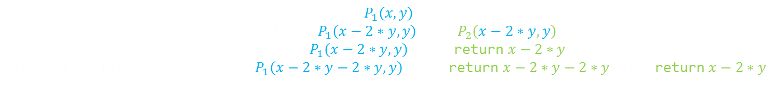








Recursion Schemes
We can unfold the definitions of the procedures.
$$P_{1}\left(x,y\right)$$
$$\text{if} x≥0 \text{then} P_{1}\left(x−2∗y,y\right) \text{else} P_{2}\left(x−2∗y,y\right)$$
$\text{if} x≥0 \text{then} P_{1}\left(x−2∗y,y\right) \text{else} \text{return}$ $x−2∗y$
$\text{if} x≥0 \text{then} \text{if} x−2∗y≥0 \text{then} P_{1}\left(x−2∗y−2∗y,y\right) \text{else} \text{return}$ $x−2∗y−2∗y \text{else} \text{return}$ $x−2∗y$
if
$$P_{1}\left(x,y\right)≔ \\ \text{if} x≥0 \\ \text{then} P_{1}\left(x−2∗y,y\right) \\ \text{else} P_{2}\left(x−2∗y,y\right)$$
$$P_{2}\left(x,y\right)≔\text{return} x$$
$$Q_{1}\left(x,y\right)≔Q_{2}(x,2∗y)$$
$$Q_{2}\left(x,y\right)≔ \\ \text{if} x≥0 \\ \text{then} Q_{2}\left(x−y,y\right) \\ \text{else} Q_{3}\left(x−y,y\right)$$
$$Q_{3}\left(x,y\right)≔\text{return} x$$
$$x≥0$$
if
return $x−2∗y$
$$x−2∗y≥0$$
if
return $x−2∗y−2∗y$
$$x−2∗y−2∗y≥0$$
if
$$⋮$$
return $x−2∗y−2∗y−2∗y$

Slide 6
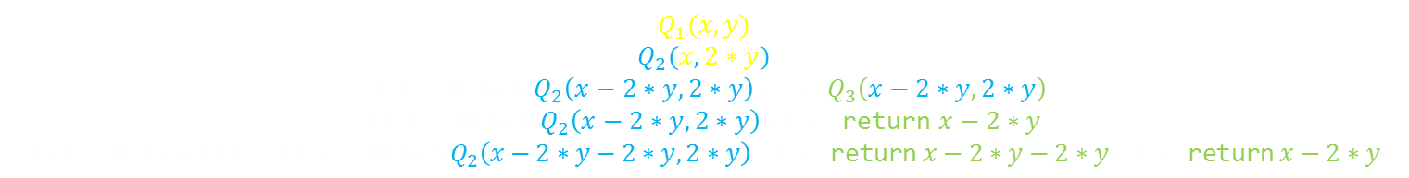

Recursion Schemes
$Q_{1}$ results in the same infinite tree.
$$Q_{1}(x,y)$$
$$Q_{2}(x,2∗y)$$
$$\text{if} x≥0 \text{then} Q_{2}\left(x−2∗y,2∗y\right) \text{else} Q_{3}\left(x−2∗y,2∗y\right)$$
$\text{if} x≥0 \text{then} Q_{2}\left(x−2∗y,2∗y\right) \text{else} \text{return}$ $x−2∗y$
$\text{if} x≥0 \text{then} \text{if} x−2∗y≥0 \text{then} Q_{2}\left(x−2∗y−2∗y,2∗y\right) \text{else} \text{return}$ $x−2∗y−2∗y \text{else} \text{return}$ $x−2∗y$
$\text{if} x≥0 \text{then} \text{if} x−2∗y≥0 \text{then} P_{1}\left(x−2∗y−2∗y,y\right) \text{else} \text{return}$ $x−2∗y−2∗y \text{else} \text{return}$ $x−2∗y$
if
$$P_{1}\left(x,y\right)≔ \\ \text{if} x≥0 \\ \text{then} P_{1}\left(x−2∗y,y\right) \\ \text{else} P_{2}\left(x−2∗y,y\right)$$
$$P_{2}\left(x,y\right)≔\text{return} x$$
$$Q_{1}\left(x,y\right)≔Q_{2}(x,2∗y)$$
$$Q_{2}\left(x,y\right)≔ \\ \text{if} x≥0 \\ \text{then} Q_{2}\left(x−y,y\right) \\ \text{else} Q_{3}\left(x−y,y\right)$$
$$Q_{3}\left(x,y\right)≔\text{return} x$$
$$x≥0$$
if
return $x−2∗y$
$$x−2∗y≥0$$
if
return $x−2∗y−2∗y$
$$x−2∗y−2∗y≥0$$
if
$$⋮$$
return $x−2∗y−2∗y−2∗y$

Slide 7

Recursion Schemes
$Q_{1}$ results in the same infinite tree.
If the schemes produce the same tree, then the initial CFGs are equivalent.
if
$$P_{1}\left(x,y\right)≔ \\ \text{if} x≥0 \\ \text{then} P_{1}\left(x−2∗y,y\right) \\ \text{else} P_{2}\left(x−2∗y,y\right)$$
$$P_{2}\left(x,y\right)≔\text{return} x$$
$$Q_{1}\left(x,y\right)≔Q_{2}(x,2∗y)$$
$$Q_{2}\left(x,y\right)≔ \\ \text{if} x≥0 \\ \text{then} Q_{2}\left(x−y,y\right) \\ \text{else} Q_{3}\left(x−y,y\right)$$
$$Q_{3}\left(x,y\right)≔\text{return} x$$
$$x≥0$$
if
return $x−2∗y$
$$x−2∗y≥0$$
if
return $x−2∗y−2∗y$
$$x−2∗y−2∗y≥0$$
if
$$⋮$$
return $x−2∗y−2∗y−2∗y$

Slide 8

Unification Modulo Nonnested Recursion Schemes
Restriction to nonnested schemes: $P(Q\left(…\right))$
Unification: Find substitution of variables such that $P\left(s_{1},…,s_{n}\right)≡Q\left(t_{1},…,t_{m}\right)$
Tree equivalence problem was known to be decidable [Sabelfeld00,Courcelle78]
We reduce the unification problem to anchored semi-unification

Slide 9
Semi-Unification
Semi-unification is undecidable
We reduce to a new decidable fragment:
anchored semi-unification
We skip the reduction for this talk

Slide 10
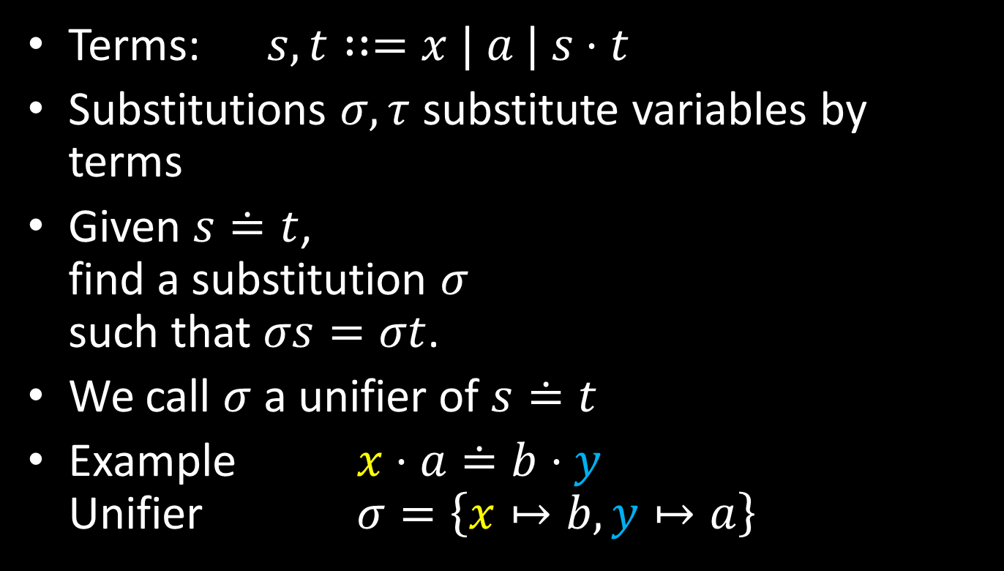
Ordinary Unification
Terms: $s,t∷=x | a | s⋅t$
Substitutions $σ,τ$ substitute variables by terms
Given $s≐t$,
find a substitution $σ$
such that $σs=σt$.
We call $σ$ a unifier of $s≐t$
Example $x⋅a≐b⋅y$
Unifier $σ=\left\{x↦b, y↦a\right\}$

Slide 11

Semi-Unification
Terms: $s,t∷=x \left| a \right| s⋅t∣αx$
An instance variable $αx$ is a variant of $x$
This must be respected by substitutions:
$σ\left(αx\right)=σ\left(\hat{α}\left(σx\right)\right)$
where $\hat{α}s$ is $s$ with every variable $y$ being replaced by $αy$
Example:
$σ≔\{x↦a⋅y,αx↦a⋅z,αy=z\}$ is ok
$σ≔\{x↦a⋅y,αx↦y\}$ is forbidden

Slide 12


Semi-Unification Example
We search for a solution $σ$
$αx≐a⋅y, αz≐a⋅\left(a⋅x\right), αy≐a⋅x, αx≐z$

Slide 13
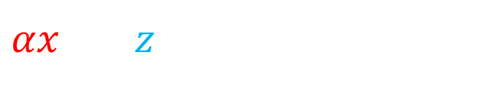

Semi-Unification Example
$αx⟹z$ since $σ\left(αx\right)=σz$
$αx≐a⋅y, αz≐a⋅\left(a⋅x\right), αy≐a⋅x, αx≐z$
$z≐a⋅y, αz≐a⋅\left(a⋅x\right), αy≐a⋅x, αx≐z$

Slide 14
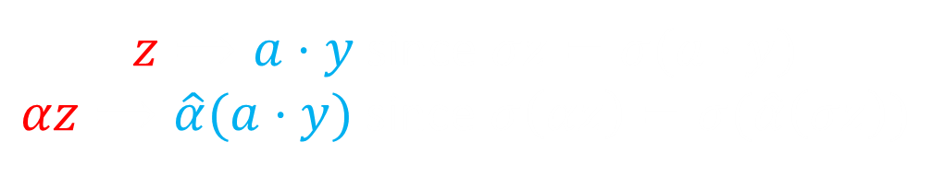

Semi-Unification Example
$z⟹a⋅y$ since $σz=σ(a⋅y)$
$αz⟹\hat{α}(a⋅y)$ since $σ\left(αz\right)=σ(\hat{α}\left(σz\right))$
$αx≐a⋅y, αz≐a⋅\left(a⋅x\right), αy≐a⋅x, αx≐z$
$z≐a⋅y, αz≐a⋅\left(a⋅x\right), αy≐a⋅x, αx≐z$
$z≐a⋅y, \hat{α}\left(a⋅y\right)≐a⋅\left(a⋅x\right), αy≐a⋅x, αx≐a⋅y$

Slide 15
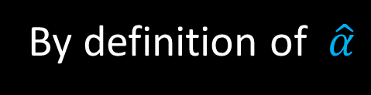

Semi-Unification Example
By definition of $\hat{α}$
$αx≐a⋅y, αz≐a⋅\left(a⋅x\right), αy≐a⋅x, αx≐z$
$z≐a⋅y, αz≐a⋅\left(a⋅x\right), αy≐a⋅x, αx≐z$
$z≐a⋅y, \hat{α}\left(a⋅y\right)≐a⋅\left(a⋅x\right), αy≐a⋅x, αx≐a⋅y$
$z≐a⋅y, a⋅αy≐a⋅\left(a⋅x\right), αy≐a⋅x, αx≐a⋅y$

Slide 16

Semi-Unification Example
Splitting the equation
$αx≐a⋅y, αz≐a⋅\left(a⋅x\right), αy≐a⋅x, αx≐z$
$z≐a⋅y, αz≐a⋅\left(a⋅x\right), αy≐a⋅x, αx≐z$
$z≐a⋅y, \hat{α}\left(a⋅y\right)≐a⋅\left(a⋅x\right), αy≐a⋅x, αx≐a⋅y$
$z≐a⋅y, a⋅αy≐a⋅\left(a⋅x\right), αy≐a⋅x, αx≐a⋅y$
$z≐a⋅y, a≐a, αy≐a⋅x, αy≐a⋅x, αx≐a⋅y$

Slide 17

Semi-Unification Example
Removing trivial equations
$αx≐a⋅y, αz≐a⋅\left(a⋅x\right), αy≐a⋅x, αx≐z$
$z≐a⋅y, αz≐a⋅\left(a⋅x\right), αy≐a⋅x, αx≐z$
$z≐a⋅y, \hat{α}\left(a⋅y\right)≐a⋅\left(a⋅x\right), αy≐a⋅x, αx≐a⋅y$
$z≐a⋅y, a⋅αy≐a⋅\left(a⋅x\right), αy≐a⋅x, αx≐a⋅y$
$z≐a⋅y, a≐a, αy≐a⋅x, αy≐a⋅x, αx≐a⋅y$
$z≐a⋅y, αy≐a⋅x, αx≐a⋅y$

Slide 18
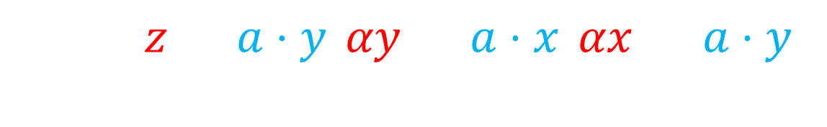

Semi-Unification Example
Now we can construct a solution
$αx≐a⋅y, αz≐a⋅\left(a⋅x\right), αy≐a⋅x, αx≐z$
$z≐a⋅y, αz≐a⋅\left(a⋅x\right), αy≐a⋅x, αx≐z$
$z≐a⋅y, \hat{α}\left(a⋅y\right)≐a⋅\left(a⋅x\right), αy≐a⋅x, αx≐a⋅y$
$z≐a⋅y, a⋅αy≐a⋅\left(a⋅x\right), αy≐a⋅x, αx≐a⋅y$
$z≐a⋅y, a≐a, αy≐a⋅x, αy≐a⋅x, αx≐a⋅y$
$z≐a⋅y, αy≐a⋅x, αx≐a⋅y$
$$σ≔\{z↦a⋅y, αy↦a⋅x, αx↦a⋅y,$$
$$αz↦a⋅\left(a⋅x\right)\}$$

Slide 19

Semi-Unification Rules
$E, αx≐s ⟹ E\left[s∕αx\right], αx≐s$
if $s$ instance-free
$E, x≐s ⟹ E\left[s/x\right], x≐s$
if $s$ instance-free
$E, s_{1}⋅s_{2}≐t_{1}⋅t_{2} ⟹ E, s_{1}≐t_{1}, s_{2}≐t_{2}$
$E, s≐s ⟹ E$

Slide 20

Semi-Unification Rules
But semi-unification is undecidable!
The rules always terminate but …
… they can get stuck.
Example:
$αx≐a, x≐αy$
Substituting $x$ would produce $α\left(αy\right)$.
We forbid this to ensure termination.

Slide 21
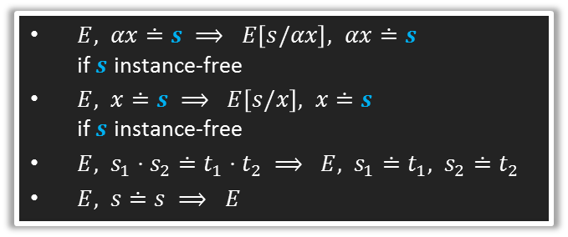

Anchored Semi-Unification
$E, αx≐s ⟹ E\left[s/αx\right], αx≐s$
if $s$ instance-free
$E, x≐s ⟹ E\left[s/x\right], x≐s$
if $s$ instance-free
$E, s_{1}⋅s_{2}≐t_{1}⋅t_{2} ⟹ E, s_{1}≐t_{1}, s_{2}≐t_{2}$
$E, s≐s ⟹ E$
Anchoredness: Invariant to ensure progress
Intuition: Whenever we see an instance variable, we can replace it by an instance-free term.
Definition: There is a partial equivalence relation $∼$ on variables such that
  If $αx∈\left(∼\right)$, then $αx≐s$ with $s$ instance-free
  If $s\left[x\right]≐t[y]$, then $x∼y$
  If $s\left[αx\right]≐t[βy]$, then $αx∼βy$
  If $x∼y$ and $αx∈\left(∼\right)$, then $αx∼αy$

Slide 22

Complexity
The rules I presented need exponential time
There is an algorithm with time $O\left(n^{3}α\left(n\right)\right)$
Idea from Unification-Closure [Huet78]:
Don‘ t perform substitutions but just record equivalences in a union-find structure.

Slide 23

References
B. Courcelle. A representation of trees by languages II. Theoretical Computer Science, 7(1):25-55, 1978.
V. Sabelfeld. The tree equivalence of linear recursion schemes. Theoretical Computer Science, 238(1-2):1-29, 2000.
G. P. Huet, Résolution d'Equations dans des Langages d'ordre 1,2,...,$ω$, Thèse d`État, Université de Paris VII, 1978
F. Baader and W. Snyder. Unification theory. In Handbook of Automated Reasoning, volume 1, pages 445-534. Elsevier, 2001.

